Slide 1
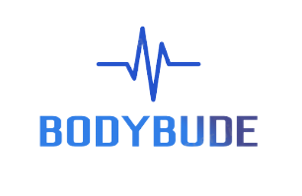
TEAM ID : 32
TEAM NAME : BODY BUDE
PROJECT TITLE : Enhanced patient care through seamless monitoring and data continuity
When Care Meets Compassion!

Slide 2





Meet the Team
SHREY NAGORI
ARNAV AGGARWAL
PRIYANSHI SHARMA
PRAGYA NIDHI
B.TECH in CSE w/s IoT
4th Year
+91 9752908818
B.TECH in CSE w/s IoT
4th Year
+91 9891761171
B.TECH in CSE w/s IoT
4th Year
+91 7976146425
B.TECH in CSE w/s IoT
4th Year
+91 7717741252

Slide 3
Table of Contents
01
02
03
04
05
MEET THE TEAM
PROBLEM
SOLUTION
PRODUCT OVERVIEW
WHAT’S UNIQUE?
06
07
08
09
10
TECH STACK
SYSTEM ARCHITECTURE
APP DESIGN
GTM STRATEGY
CONCLUSION

Slide 4

Problem
Statement 01
Manual monitoring during ambulance transport is time-consuming and prone to human error, diverting attention from critical tasks.
Statement 02
Traditional monitoring equipment is bulky, occupying valuable space and hindering movement within the ambulance, leading to operational challenges and patient discomfort.
Statement 03
Manual documentation of vital signs may result in incomplete or inaccurate records, hindering continuity of care and timely intervention upon hospital arrival.

Slide 5
Statistics
Up to 46% of adverse events during ambulance transport are related to inadequate patient monitoring and assessment (Journal of Emergency Medicine).
Space constraints and equipment bulkiness can delay life-saving procedures, impacting up to 25% of cardiac arrest outcomes during ambulance transport (American Heart Association).
According to a study published in the Indian Heart Journal in 2019, it was estimated that approximately 10-15% of total deaths in India are due to sudden cardiac arrest.

Slide 6
Solution
CUTTING-EDGE TECHNOLOGIES
Implement an IoT-based automated monitoring system to continuously track patient vitals, reducing reliance on manual processes and minimizing human error.
ALERTS
Provide functionality of real-time alerts to the family members and hospital, in case of any emergency situations like vitals going below expected levels.
BODY BUDE
Utilize a compact and integrated monitoring device, Body BudE, to save space and enhance comfort within the ambulance.
REAL-TIME MONITORING
Enable real-time transmission of vital sign data to the hospital's cloud server, ensuring accurate and accessible patient information for timely medical intervention.

Slide 7
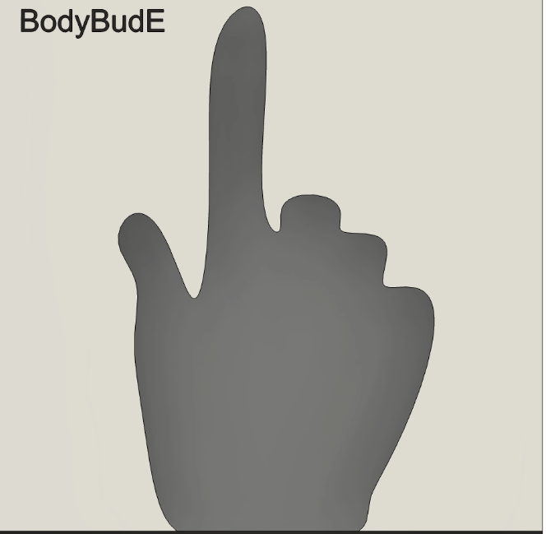
Overview
Product Overview
MAX30102 AND DS18B20 SENSOR
FLUTTER APPLICATION
ESP32 MICROCONTROLLER
THINGSPEAK CLOUD AND 5G TRANSMISSION

Slide 8
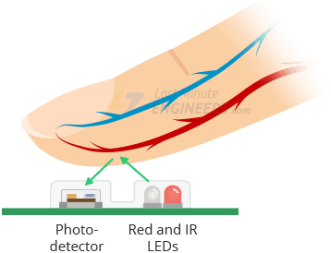
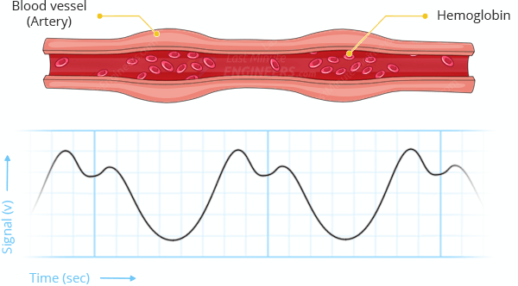
The sensor employs photodiodes to measure the amount of light reflected by the blood. The photodiodes receive the light signals and convert them into analog data. This data is then amplified and converted into digital data by an analog-to-digital converter (ADC).
The sensor incorporates infrared and red LEDs, along with a photonic filter, to generate appropriate light that penetrates the skin and red-colored tissues. The infrared LED penetrates deeper into the skin, while the red LED penetrates further away. When the light is projected through the skin, it encounters reflection from the flowing blood in the blood vessels beneath the skin.

Slide 9
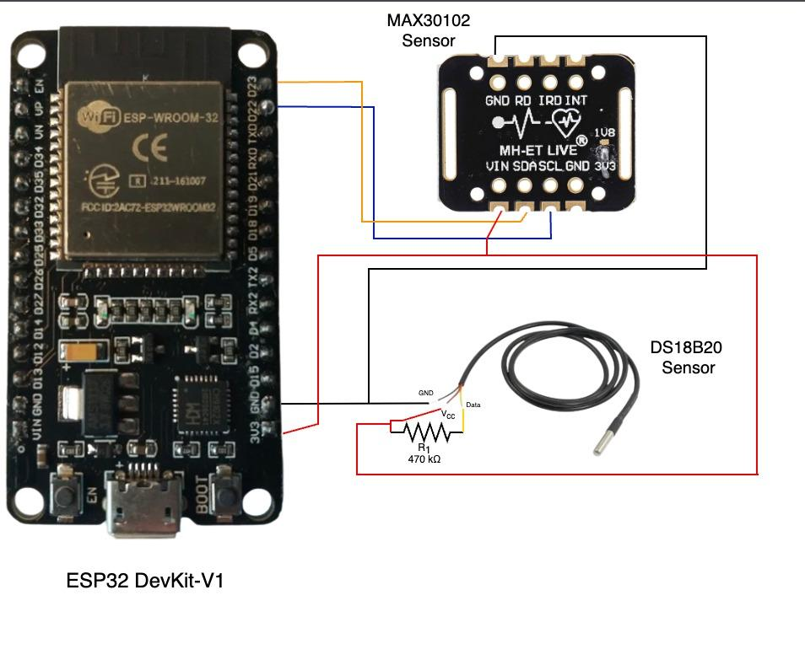

Slide 10

What’s Unique
USP
01
05
Automated Alerts for Critical Conditions
Integrated IoT Technology
02
04
Seamless Data Transmission
Accuracy and Reliability.
03
Automated Real-Time Monitoring

Slide 11
Tech Stack
Hardware Components
ESP32 Development Board
MAX30102 Pulse Oximeter and Heart Rate Sensor
DS18B20 Digital Temperature Sensor
Software Components
Arduino IDE
VS Code
Autodesk Fusion 360
Cloud Infrastructure
Cloud-based Database - Thingspeak
Flutter Application
Web Dashboard

Slide 12
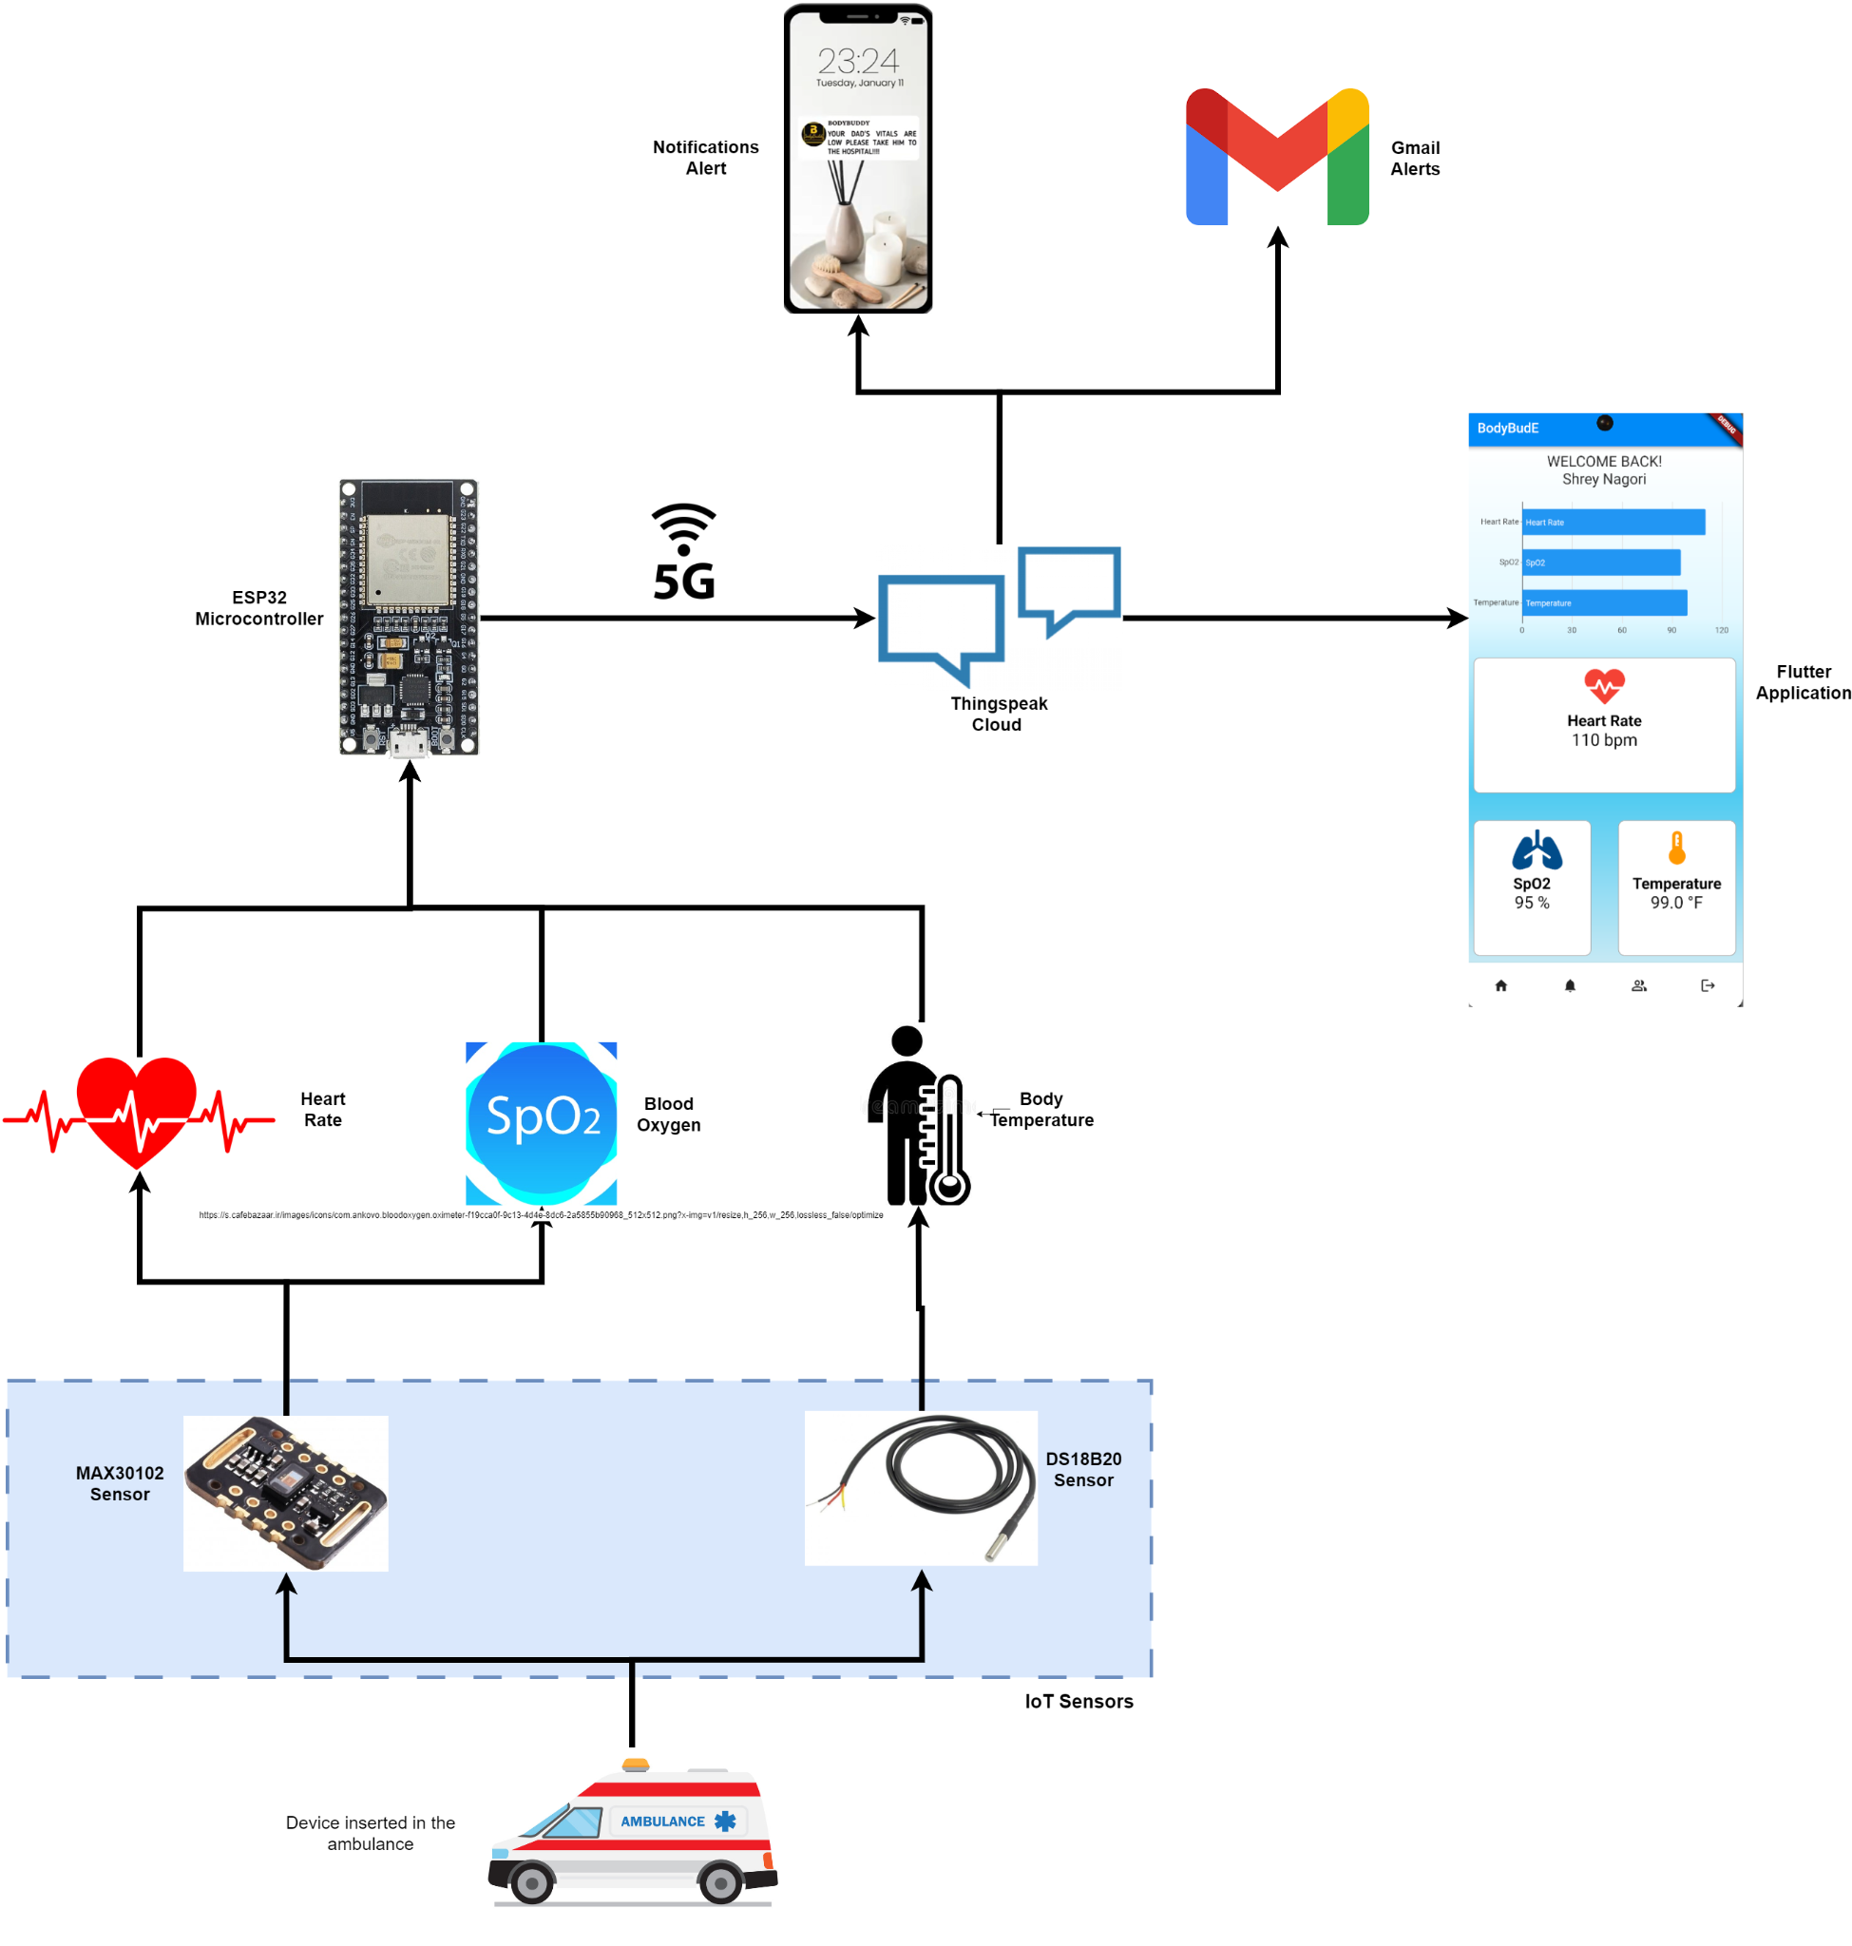
System Architecture

Slide 13
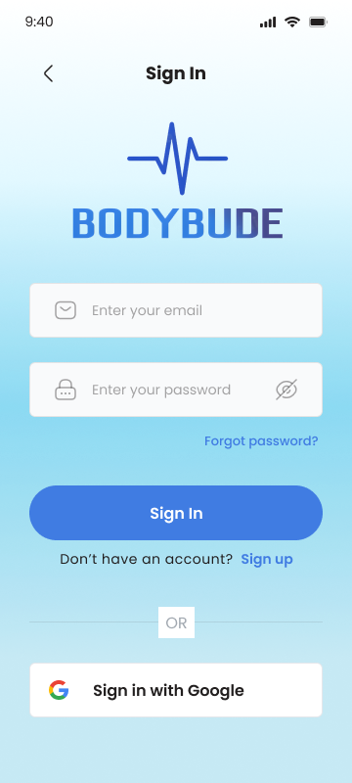
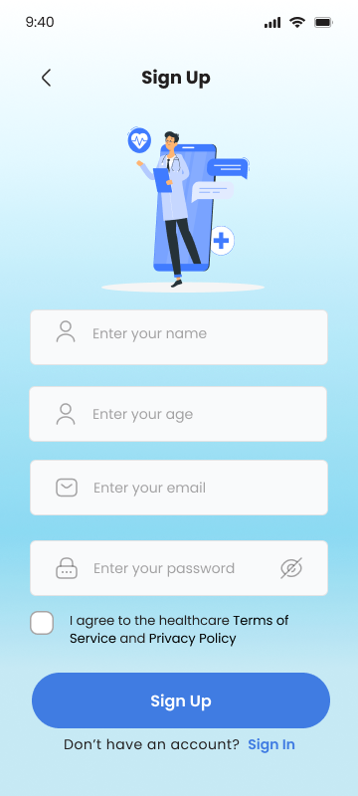
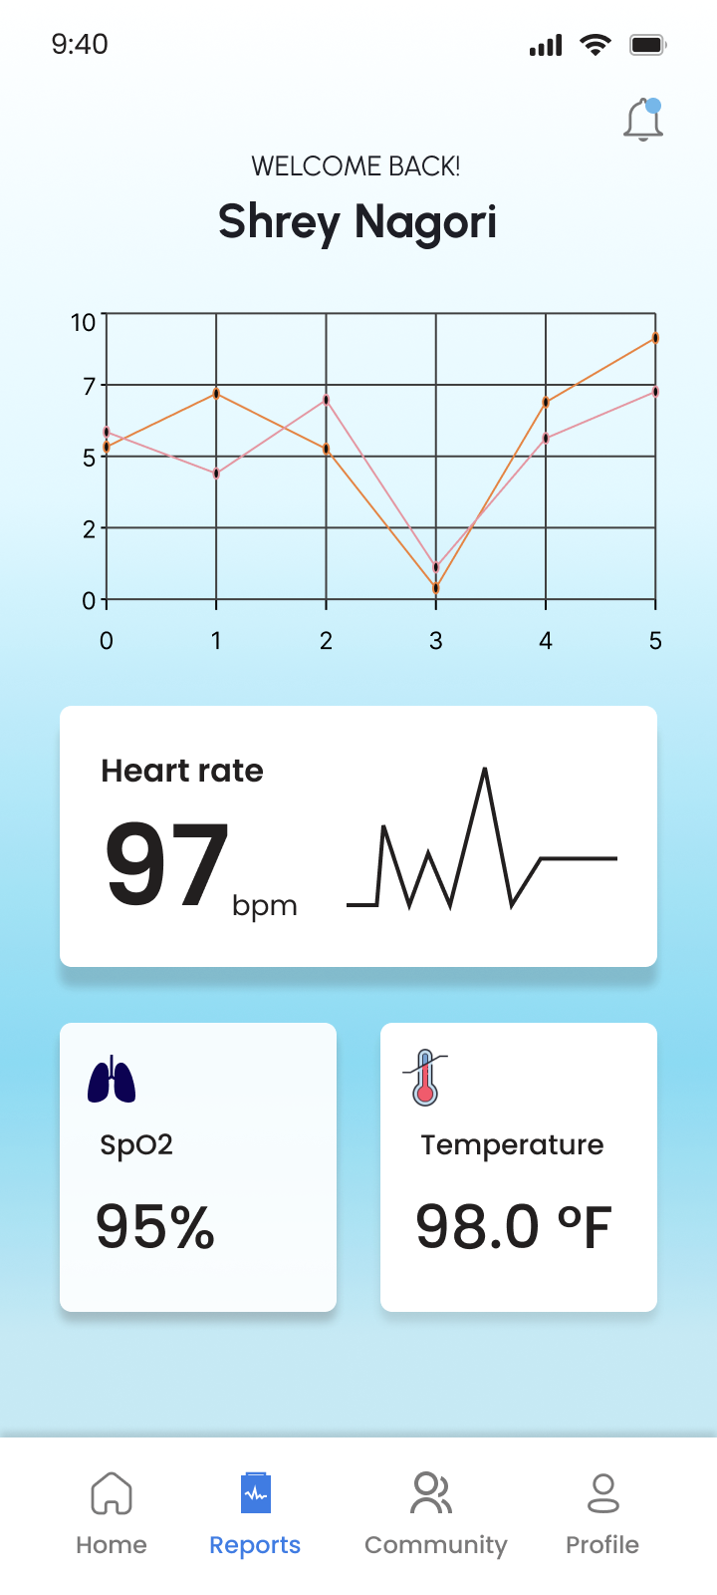
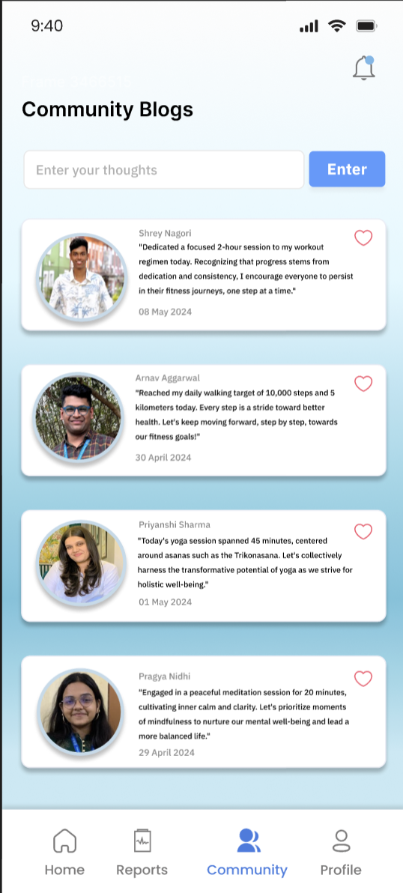
Application Design

Slide 14
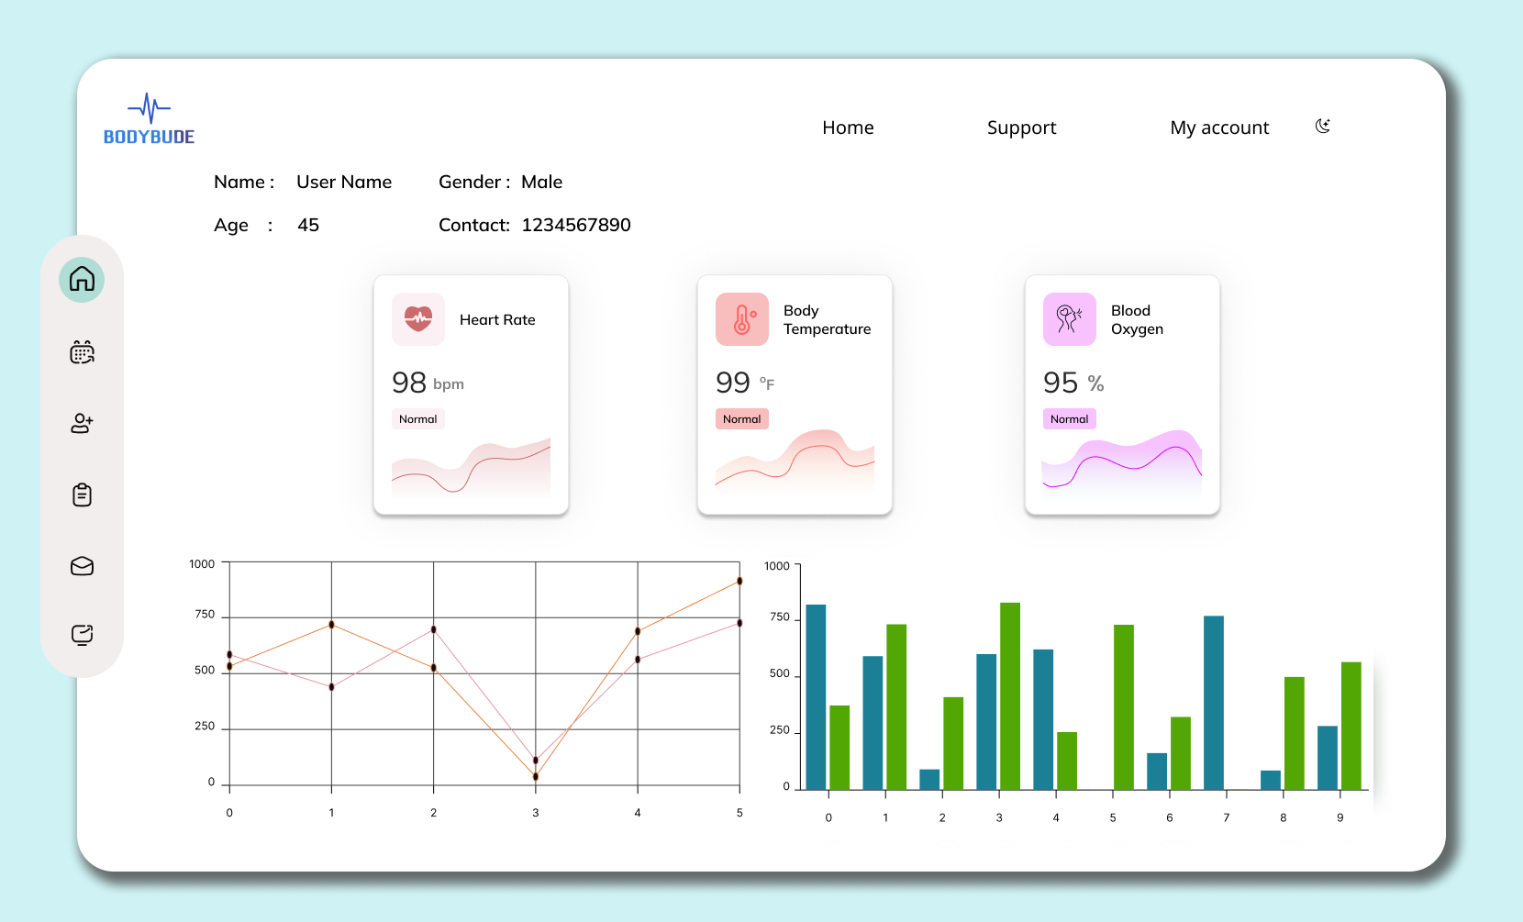
Web Dashboard

Slide 15
Go-To-Market Strategy
Customer Support and Training
Product Development and Testing
Building Brand Awareness amongst Hospitals
Market Research and Validation
Strategic Partnerships and Alliances
Regulatory Compliance and Certification

Slide 16

Conclusion
Body BudE revolutionizes emergency medical services by automating patient monitoring during ambulance transport. Its compact design and real-time data transmission ensure accurate, continuous oversight of vital signs, freeing EMS personnel from manual processes and enhancing patient care. With Body BudE, every second in transit is optimized for safety and timely intervention, paving the way for better patient outcomes and a more efficient healthcare system.
Body BudE: Revolutionizing Ambulance Care with Real-Time, Automated Patient Monitoring.

Slide 17


